Slide 1

Computer Programming, Basics
Linux2

Slide 2
Headlines
Source Control
Linux1
Linux2
Compilers1
Compilers2
Golang1
Golang2
Golang3

Slide 3
What about last Homeworks?
Take a look at bash commands.
Take a look at cron-tab. What is it and how to use it?
Create a bash file which
connects to a git repository,
create a simple commit every hour
and then push it to the github.
How to concatenate splitt ed files (split).

Slide 4
Linux distribution
often abbreviated as distro
is an operating system made from a software collection that is based upon the Linux kernel and, often, a package management system.
Debian, by Ian Murock, 1993
Ubuntu
Kubuntu
Slackware, by Patrick Volkerding, 1993
S.u.S.E
OpenSUSE
Red Hat, by American multi-national software company, 2000
Red Hat Enterprise
CentOS
Notes:
https://en.wikipedia.org/wiki/Linux_distribution
https://upload.wikimedia.org/wikipedia/commons/1/1b/Linux_Distribution_Timeline.svg

Slide 5
Linux distribution
Enoch, renamed to Gentoo, by Daniel Robbins, 2000
Gentoo
ChromeOS
Arch, by Levente Polyak, 2002
Arch Linux ARM
Android, by mostly google, 2008
Android Wear
Wear OS
Notes:
https://en.wikipedia.org/wiki/Linux_distribution
https://upload.wikimedia.org/wikipedia/commons/1/1b/Linux_Distribution_Timeline.svg

Slide 6
Package manager
We have package manager for every programming tool which has packages. Linux is not an exception
Some package manager examples:
C#: nuget
Python: pip
JavaSctip: npm
Windows: choco
etc
Some Linux package manager:
> dpkg, Debian package management system
> rpm, redhat package manager
> Pacman package manager, Arch Linux
> Zypper package manager, openSUSE
> Portage, Gentoo, ChromeOS
> winget, windows10, > choco, windows

Slide 7
Advanced Package Tool
.deb -> dpkg -> Deity -> Advanced Package Tool (apt)
> /etc/apt/sourcsources.des.list
> /etc/apt//
> apt search [package-name]
> apt list
Notes:
One of the oldest Linux distributions currently maintained, Debian's system is very similar to RPM-based systems. They use .deb packages, which can be managed by a tool called dpkg. dpkg is very similar to rpm in that it was designed to manage packages that are available locally. It does no dependency resolution (although it does dependency checking), and has no reliable way to interact with remote repositories. In order to improve the user experience and ease of use, the Debian project commissioned a project called Deity. This codename was eventually abandoned and changed to Advanced Package Tool (APT).

Slide 8
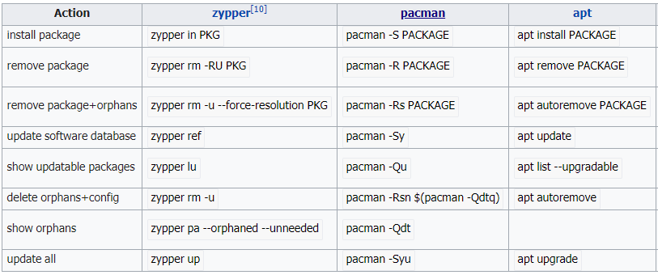
Some command comparison
Notes:
https://en.wikipedia.org/wiki/Package_manager

Slide 9
Practic, installing neo4j
> wget -O - https://debian.neo4j.org/neotechnology.gpg.key | sudo apt-key add -
> echo 'deb https://debian.neo4j.org/repo stable/' | sudo tee /etc/apt/sources.list.d/neo4j.list
> sudo apt update
> sudo apt install neo4j
> neo4j --version
> vim /etc/neo4j/neo4j.conf
> neo4j start

Slide 10
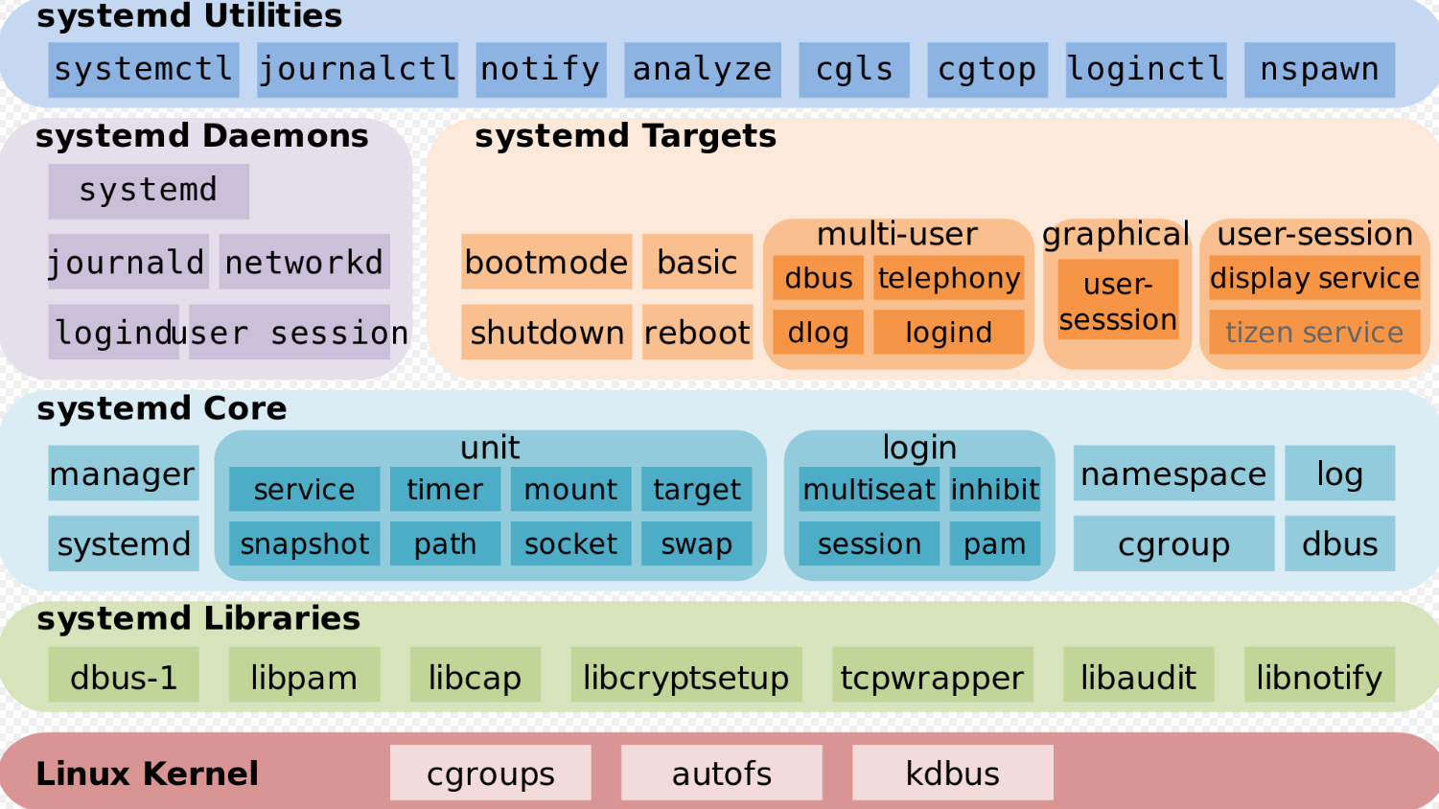
Services
A service is a program that runs in the background outside the interactive control of system users as they lack an interface.
> systemd
Notes:
systemd is a software suite that provides an array of system components for Linux operating systems.

Slide 11
Practice, working with services
> systemctl status [service-name]
> systemctl stop [service-name]
> systemctl start [service-name]
> systemctl restart [service-name]
> service --status-all
> service [service-name] status
> service [service-name] stop
> service [service-name] start
> service [service-name] restart

Slide 12
Practice, working with services
> /etc/init.d/[service-name] status
> /etc/init.d/[service-name] start
> /etc/init.d/[service-name] stop
> /etc/init.d/[service-name] restart

Slide 13
Homework ☺
Read about mongodb, what is it, and how it deal with data?
Install neo4j as it shows in the course.
Check installation. Check service status. Check the port it uses.
We work with neo4j in the golang sessions.
Install mongodb with their repository, like neo4j?
Check installation. Check service status. Check the port it uses.
Create a simple db and a simple table.
Read about redis, what is it, and how it deal with data?
Install redis with the default ubuntu deb packages.
Check installation. Check service status. Check the port it uses.
Create a simple key-value pair.
Every time you commit a message read a key-value and then add it to the commit message, then increment the value. Next time the message has the incremented value, hoora.

